Slide 1
OOPS 6
COLLECTION FRAMEWORK
LECTURE 8

Slide 2
COLLECTIONS
A Collection represents a single unit of objects, i.e., a group.
A collection in java is a container object that is used for storing
multiple homogeneous (same data type)
and heterogeneous,(different data types)
duplicate,
and unique elements
without any size limitation.

Slide 3
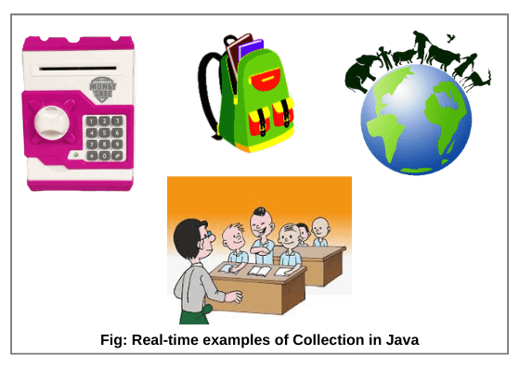
REAL TIME EXAMPLE

Slide 4
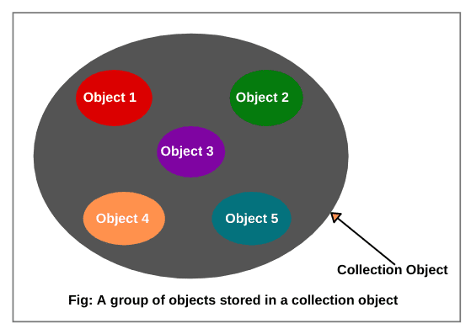
DIAGRAMATIC REPRESENTATION

Slide 5
COLLECTION FRAMEWORK
A framework in java is a set of several classes and interfaces which provide a ready-made architecture.
A collections framework is a class library to handle groups of objects.
It is present in java. util package.
It allows us to store, retrieve, and update a group of objects.

Slide 6
NEED OF COLLECTION FRAMEWORK
Reduced programming efforts.
Consistent methods and API.
Increase speed and accuracy.
Facilitates software reuse.
Interoperability (ability to exchange and use information)among unrelated APIs.
Fewer efforts to design new APIs.

Slide 7
JAVA COLLECTION FRAMEWORK HIERARCHY
The hierarchy of the entire collection framework consists of
four core interfaces such as
Collection,
List,
Set,
Map,
and two specialized interfaces named
SortedSet
SortedMap
for sorting.

Slide 8
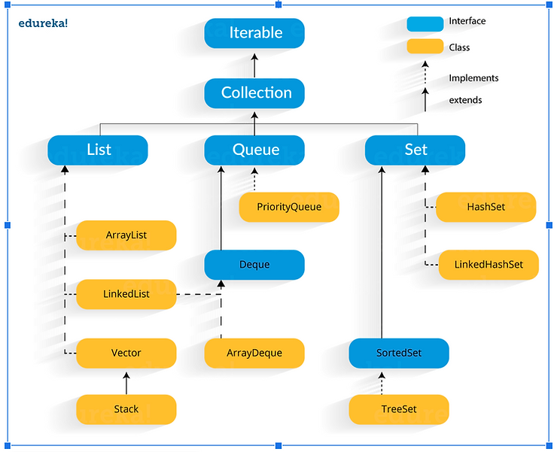

Slide 9
EXPLAINATION
Extends:
Extends is a keyword that is used for developing inheritance between two classes and two interfaces.
Implements:
Implements is a keyword used for developing inheritance between class and interface.

Slide 10
COLLECTION INTERFACE
The basic interface of the collections framework is the Collection interface which is the root interface of all collections in the API (Application programming interface).
It is placed at the top of the collection hierarchy in java.
It provides the basic operations for adding and removing elements in the collection.
The Collection interface extends the Iterable interface.
The iterable interface has only one method called iterator().

Slide 11
Continue…
The function of the iterator method is to return the iterator object.
Using this iterator object, we can iterate over the elements of the collection.
List, Queue, and Set have three component which extends the Collection interface.
A map is not inherited by Collection interface.

Slide 12
LIST INTERFACE
This interface represents a collection of elements whose elements are arranged sequentially ordered.
List maintains an order of elements means the order is retained in which we add elements, and the same sequence we will get while retrieving elements.
We can insert elements into the list at any location. The list allows storing duplicate elements in Java.
ArrayList, vector, and LinkedList are three concrete subclasses that implement the list interface.

Slide 13
SET INTERFACE
This interface represents a collection of elements that contains unique elements. i.e., It is used to store the collection of unique elements.
Set interface does not maintain any order while storing elements and while retrieving, we may not get the same order as we put elements. All the elements in a set can be in any order.
Set does not allow any duplicate elements.
HashSet, LinkedHashSet, TreeSet classes implements the set interface and the sorted interface extends a set interface.
It can be iterated by using Iterator but cannot be iterated using ListIterator.

Slide 14
SORTED SET INTERFACE
This interface extends a set whose iterator
transverse its elements according to their natural ordering.
TreeSet implements the sorted interface.

Slide 15
QUEUE INTERFACE
A queue is an ordered of the homogeneous group of elements in which new elements are added at one end(rear) and elements are removed from the other end(front).
Just like a queue in a supermarket or any shop.
This interface represents a special type of list whose elements are removed only from the head.
LinkedList, Priority queue, Array Queue, Priority Blocking Queue, and Linked Blocking Queue are the concrete subclasses that implement the queue interface.

Slide 16
DEQUE INTERFACE
A deque (double-ended queue) is a sub-interface of queue interface. It is usually pronounced “deck”.
This interface was added to the collection framework in Java SE 6.
Deque interface extends the queue interface and uses its method to implement deque.
It is a linear collection of elements in which elements can be inserted and removed from either end. i.e., it supports insertion and removal at both ends of an object of a class that implements it.
LinkedList and ArrayDeque classes implement the Deque interface.

Slide 17
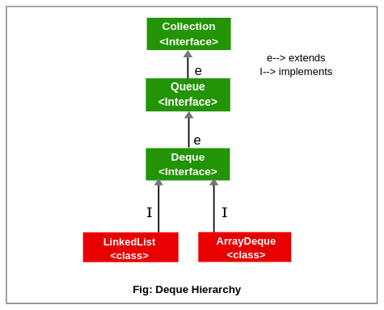
HIERARCHY OF DEQUE INTERFACE

Slide 18
MAP INTERFACE
Map interface is not inherited by the collection interface.
It represents an object that stores and retrieves elements in the form of a Key/Value pairs and their location within the Map are determined by a Key.
Map uses a hashing technique for storing key-value pairs.
It doesn’t allow to store the duplicate keys but duplicate values are allowed.
HashMap, HashTable, LinkedHashMap, TreeMap classes implements Map interface.
SORTED MAP INTERFACE
This interface represents a Map whose elements are stored in their natural ordering. It extends the Map interface which in turn is implemented by TreeMap classes.

Slide 19
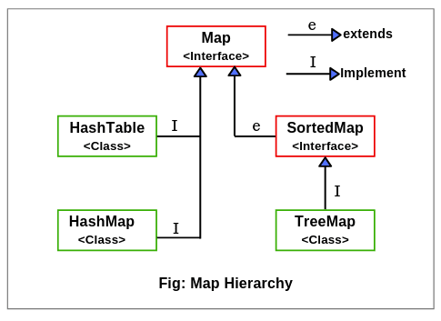
HIERARCHY OF MAP INTERFACE

Slide 20
COLLECTION CLASS
AbstractCollection: It implements most of the collection interface. It is a superclass for all of the concrete collection classes.
AbstractList: It extends AbstractCollection and implements most of the List interface.
AbstractQueue: It extends AbstractCollection and implements the queue interface.
AbstractSequentialList: It extends AbstractList and uses sequential order to access elements.
AbstractSet: Extends AbstractCollection and implements most of the set interface.
ArrayList: It implements a dynamic array by extending AbstractList.
.

Slide 21
EnumSet: Extends AbstractSet for use with enum elements.
HashSet: Extends AbstractSet for use with a hash table.
LinkedHashSet: Extends HashSet to allow insertion-order iterations.
LinkedList: Implements a linked list by extending AbstractSequentialList.
PriorityQueue: Extends Abstract Queue to support a priority-based queue.
TreeSet: Extends AbstractSet and implements the Sorted Set interface.

Slide 22
LINK FOR METHODS IN COLLECTION FRAMEWORK
https://docs.oracle.com/en/java/javase/11/docs/api/java.base/java/util/Collection.html

Slide 23
CONCRETE COLLECTIONS
A set is a collection of elements without duplicates.
The add method of a set first tries to find the object to be added,
and adds it only if it is not yet present.
The Java collections library supplies a HashSet class that implements a set based on a hash table.

Slide 24
CONCRETE COLLECTION IN JAVA LIBRARY
Collection Type | Description
ArrayList | An indexed sequence that grows and shrinks dynamically
LinkedList | An ordered sequence that allows efficient insertions and removal at any location
HashSet | An unordered collection that rejects duplicates
TreeSet | A sorted set

Slide 25
ARRAYLIST
This class provides implementation of an array based data structure that is used to store elements in linear order.
ArrayList class extends AbstractList class and implements the List interface.
ArrayList supports dynamic array that can grow as needed.
It can contain Duplicate elements and it also maintains the insertion order.
Manipulation is slow because a lot of shifting needs to be occurred if any element is removed from the array list.
ArrayLists are not synchronized.
ArrayList allows random access because it works on the index basis.

Slide 26
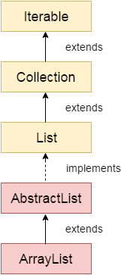
DIAGRAMATIC REPRESENTATION

Slide 27
SYNTAX
For integer values:
ArrayList<int> al = ArrayList<int>(); // does not work
ArrayList<Integer> al = new ArrayList<Integer>(); // works fine
For string values:
ArrayList<String> list=new ArrayList<String>();

Slide 28
ACTIVITY 1
import java.util.*;
class Demo {
public static void main(String[] args)
{
ArrayList< String> al = new ArrayList< String>();
al.add("ab");
al.add("bc");
al.add("cd");
System.out.println(al);
}
}

Slide 29
OUTPUT
[ab,bc,cd]

Slide 30
ACTIVITY-2
import java.util.*;
public class ArrayListExample1{
public static void main(String args[]){
ArrayList<String> list=new ArrayList<String>();//Creating arraylist
list.add("Mango");//Adding object in arraylist
list.add("Apple");
list.add("Banana");
list.add("Grapes");
//Printing the arraylist object
System.out.println(list);
}
}

Slide 31
OUTPUT
[Mango,Apple,Banana,Grapes]

Slide 32
ACTIVITY-3
import java.util.*;
public class ArrayListExample3{
public static void main(String args[]){
ArrayList<String> list=new ArrayList<String>();//Creating arraylist
list.add("Mango");//Adding object in arraylist
list.add("Apple");
list.add("Banana");
list.add("Grapes");
//Traversing list through for-each loop
for(String fruit: list)
System.out.println(fruit);
}
}

Slide 33
OUTPUT
Mango
Apple
Banana
Grapes

Slide 34
Ways to iterate the elements of the collection in Java
There are various ways to traverse the collection elements:
By Iterator interface.
By for-each loop.
By ListIterator interface.
By for a loop.
By forEach() method.
By forEachRemaining() method.

Slide 35
LINKEDLIST
Java LinkedList class can contain duplicate elements.
Java LinkedList class maintains insertion order.
Java LinkedList class is non synchronized.
In Java LinkedList class, manipulation is fast because no shifting needs to occur.
Java LinkedList class can be used as a list, stack or queue.

Slide 36
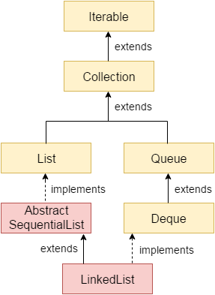
DIAGRAMATIC REPRESENTATION

Slide 37
LINKED LIST CLASS DECLARATION
public class LinkedList<E> extends AbstractSequentialList<E> implements List<E>, Deque<E>, Cloneable, Serializable

Slide 38
ACTIVITY-4
import java.util.*;
public class LinkedList1{
public static void main(String args[]){
LinkedList<String> al=new LinkedList<String>();
al.add("Ravi");
al.add("Vijay");
al.add("Ravi");
al.add("Ajay");
Iterator<String> itr=al.iterator();
while(itr.hasNext()){
System.out.println(itr.next());
}
}
}

Slide 39
OUTPUT
Ravi
Vijay
Ravi
Ajay

Slide 40
ACTIVITY-5
import java.util.*; //PROGRAM FOR REVERSING ORDER OF THE LIST
public class LinkedList4{
public static void main(String args[]){
LinkedList<String> ll=new LinkedList<String>();
ll.add("Ravi");
ll.add("Vijay");
ll.add("Ajay");
//Traversing the list of elements in reverse order
Iterator i=ll.descendingIterator();
while(i.hasNext())
{
System.out.println(i.next());
}
}

Slide 41
OUTPUT
Ajay
Vijay
Ravi

Slide 42
HASHSET
HashSet stores the elements by using a mechanism called hashing.
HashSet contains unique elements only.
HashSet allows null value.
HashSet class is non synchronized.
HashSet doesn't maintain the insertion order. Here, elements are inserted on the basis of their hashcode.
HashSet is the best approach for search operations.
The initial default capacity of HashSet is 16, and the load factor is 0.75.

Slide 43
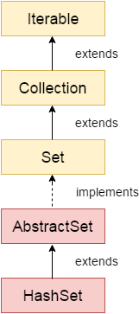
DIAGRAMATIC REPRESENTATION

Slide 44
SYNTAX
public class HashSet<E> extends AbstractSet<E> implements Set<E>, Cloneable, Serializable

Slide 45
ACTIVITY- 6
import java.util.*;
class HashSet1{
public static void main(String args[]){
//Creating HashSet and adding elements
HashSet<String> set=new HashSet();
set.add("One");
set.add("Two");
set.add("Three");
set.add("Four");
set.add("Five");
Iterator<String> i=set.iterator();
while(i.hasNext())
{
System.out.println(i.next());
}
}
}

Slide 46
OUTPUT
Five
One
Four
Two
Three

Slide 47
ACTIVITY-7
import java.util.*;
class HashSet2{
public static void main(String args[]){
//Creating HashSet and adding elements
HashSet<String> set=new HashSet<String>();
set.add("Ravi");
set.add("Vijay");
set.add("Ravi");
set.add("Ajay");
//Traversing elements
Iterator<String> itr=set.iterator();
while(itr.hasNext()){
System.out.println(itr.next());
}
}

Slide 48
OUTPUT
Ajay
Vijay
Ravi

Slide 49
HASHMAP
Java HashMap contains values based on the key.
Java HashMap contains only unique keys.
Java HashMap may have one null key and multiple null values.
Java HashMap is non synchronized.
Java HashMap maintains no order.
The initial default capacity of Java HashMap class is 16 with a load factor of 0.75.

Slide 50
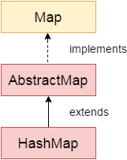
DIAGRAMATIC REPRESENTATION

Slide 51
SYNTAX
K: It is the type of keys maintained by this map.
V: It is the type of mapped values.
public class HashMap<K,V> extends AbstractMap<K,V> implements Map<K,V>, Cloneable, Serializable

Slide 52
ACTIVITY-8
import java.util.*;
public class HashMapExample1{
public static void main(String args[]){
HashMap<Integer, String> map=new HashMap<Integer, String>();//Creating HashMap
map. put(1,"Mango"); //Put elements in Map
map.put(2,"Apple");
map.put(3,"Banana");
map.put(4,"Grapes");
System.out.println("Iterating Hashmap...");
for(Map. Entry m : map.entrySet()){
System.out.println(m.getKey()+" "+m.getValue());
}
}
}

Slide 53
OUTPUT
Iterating HashMap…..
Mango
Apple
Banana
Grapes

Slide 54
ACTIVITY-9
import java.util.*;
public class HashMapExample2{
public static void main(String args[]){
HashMap<Integer, String> map=new HashMap<Integer, String>();//Creating HashMap
map.put(1,"Mango"); //Put elements in Map
map.put(2,"Apple");
map.put(3,"Banana");
map.put(1,"Grapes"); //trying duplicate key
System.out.println("Iterating Hashmap...");
for(Map. Entry m : map.entrySet()){
System.out.println(m.getKey()+" "+m.getValue());
}
}
}

Slide 55
OUTPUT
Iterating Hashmap….
1.Grapes
2.Apple
3.Banana

Slide 56
DIFFERENCE BETWEEN SET,MAP AND LIST INTERFACE
List | Set | Map
The list interface allows duplicate elements | Set does not allow duplicate elements. | The map does not allow duplicate elements
The list maintains insertion order. | Set do not maintain any insertion order. | The map also does not maintain any insertion order.
We can add any number of null values. | But in set almost only one null value. | The map allows a single null key at most and any number of null values.
List implementation classes are Array List, LinkedList. | Set implementation classes are HashSet, LinkedHashSet, and TreeSet. | Map implementation classes are HashMap, HashTable, TreeMap, ConcurrentHashMap, and LinkedHashMap.
The list provides get() method to get the element at a specified index. | Set does not provide get method to get the elements at a specified index | The map does not provide get method to get the elements at a specified index
If you need to access the elements frequently by using the index then we can use the list | If you want to create a collection of unique elements then we can use set | If you want to store the data in the form of key/value pair then we can use the map.
To traverse the list elements by using Listlterator. | Iterator can be used traverse the set elements | Through keyset, value, and entry set.

Slide 57
SELF STUDY TOPICS
Sort method for objects of user defined class.
How to implement equal and comparable and comparator interface.
TreeMap ,TreeSet working for custom objects.

Slide 58
PROGRAMMING QUESTIONS
Everything around duplicates and finding unique.

Slide 59
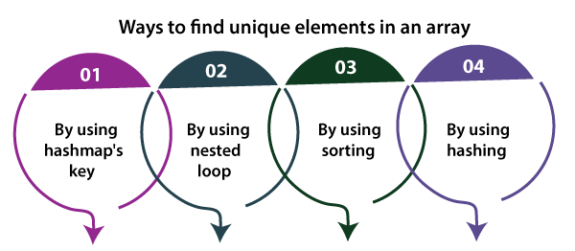
ALGORITHM
By storing all the elements to the HashMap's key.
By using nested loop.
By using sorting.
By using hashing.

Slide 60
QUESTION-2
Everything around dynamically generated values that are to be stored.

Slide 61
ALGORITHM
Use the ArrayList for these question.
Add the elements by using add() method.
Then store the value.
Using iterator you can print these stored value.

Slide 62
ASSIGNMENT
Everything around storing values where data length isn’t available front.
Practice questions like these based on collection framework.

Slide 63
INTERVIEW QUESTIONS
What do you understand by Collection Framework in Java?
Describe the Collection hierarchy in Java.
List down the primary interfaces provided by Java Collections Framework?(LIST,SET,QUEUE)
Why Collection doesn’t extend the Cloneable and Serializable interfaces?
Why Collection doesn’t extend the Cloneable and Serializable interfaces?
How the Collection objects are sorted in Java?
Refer J10B1 and 9th module for questions and answers.

Slide 64
ANSWER SLIDES
REFER SLIDE
REFER SLIDE
REFER SLIDE
.The Collection interface in Java specifies a group of objects called elements. The maintainability and ordering of elements is completely dependent on the concrete implementations provided by each of the Collection. Thus, there is no use of extending the Cloneable and Serializable interfaces.

Slide 65
CONTINUE…
Iterator in Java is an interface of the Collection framework present in java.util package. It is a Cursor in Java which is used to iterate a collection of objects. Below are a few other major functionalities provided by the Iterator interface:
Traverse a collection object elements one by one
Known as Universal Java Cursor as it is applicable for all the classes of the Collection framework
Supports READ and REMOVE Operations.
Iterator method names are easy to implement
Sorting in Java Collections is implemented via Comparable and Comparator interfaces. When Collections.sort() method is used the elements get sorted based on the natural order that is specified in the compareTo() method. On the other hand when Collections.sort(Comparator) method is used it sorts the objects based on compare() method of the Comparator interface

Slide 66
THANK YOU

